Slide 1
Project Eclipse
Heavy Guys

Slide 2
Inhoud
Over ons
Ons idee
Game (Jarno, Alex en Patricia)
Website (Jens)

Slide 3
Over ons
Jens
Jarno
Patricia
Alex
Heavy Guys

Slide 4
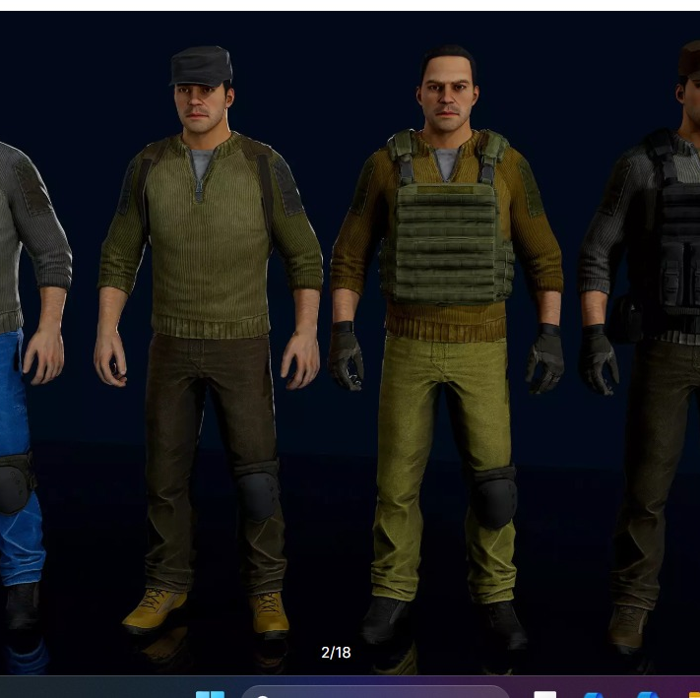
Ons idee
Apocalyps
Horror
Puin

Slide 5
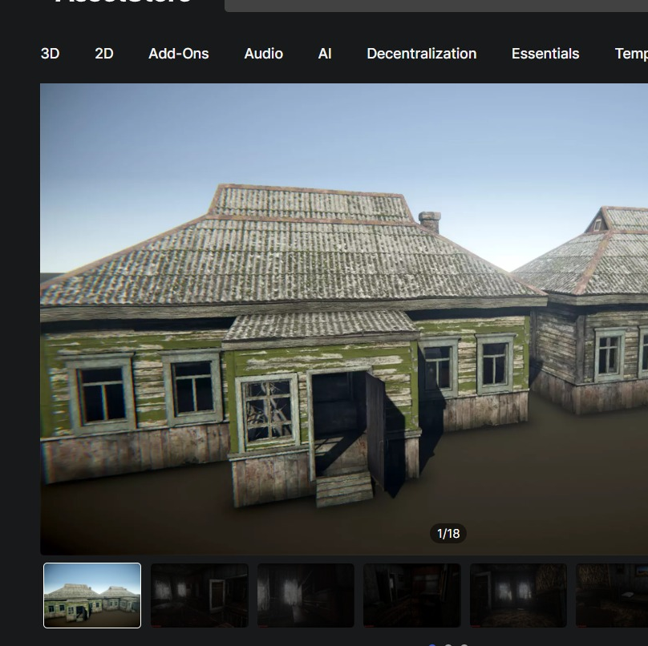
Game
Pandemie
Puinruimen
Overleven
Zoektocht

Slide 6

Website
Inspiratie (Rockstar, enz.)
Promotie
Downloadbare game

